Slide 1
Dice and Rules Toolkit
Project Overview - Ben Caruthers

Slide 2
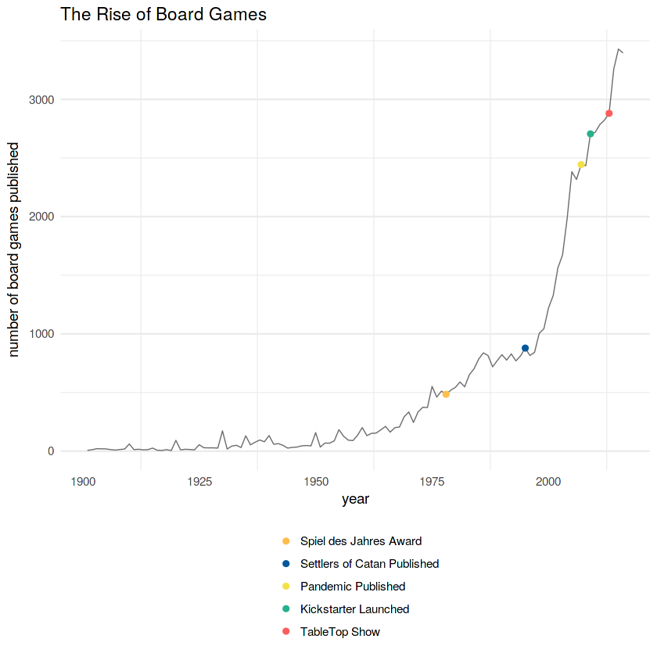
Problem Description
One of the fastest growing sectors within entertainment is surprisingly found in tabletop games.
A not insignificant portion of these games are classified as tabletop role playing games or RPG’s.
Most famous among these types of games is Dungeons & Dragons known colloquially as “D&D” Now in its 5th edition, it is the de facto entry point into the hobby.
When playing D&D people often don’t know all the rules (like programming) The game is fairly slow to begin with and is brought to a halt when rules and specific situations warrant further investigation into the rule book(s).
Verstraeten, The Rise of Board Games,
https://medium.com/@Juliev/the-rise-of-board-games-a7074525a3ec

Slide 3
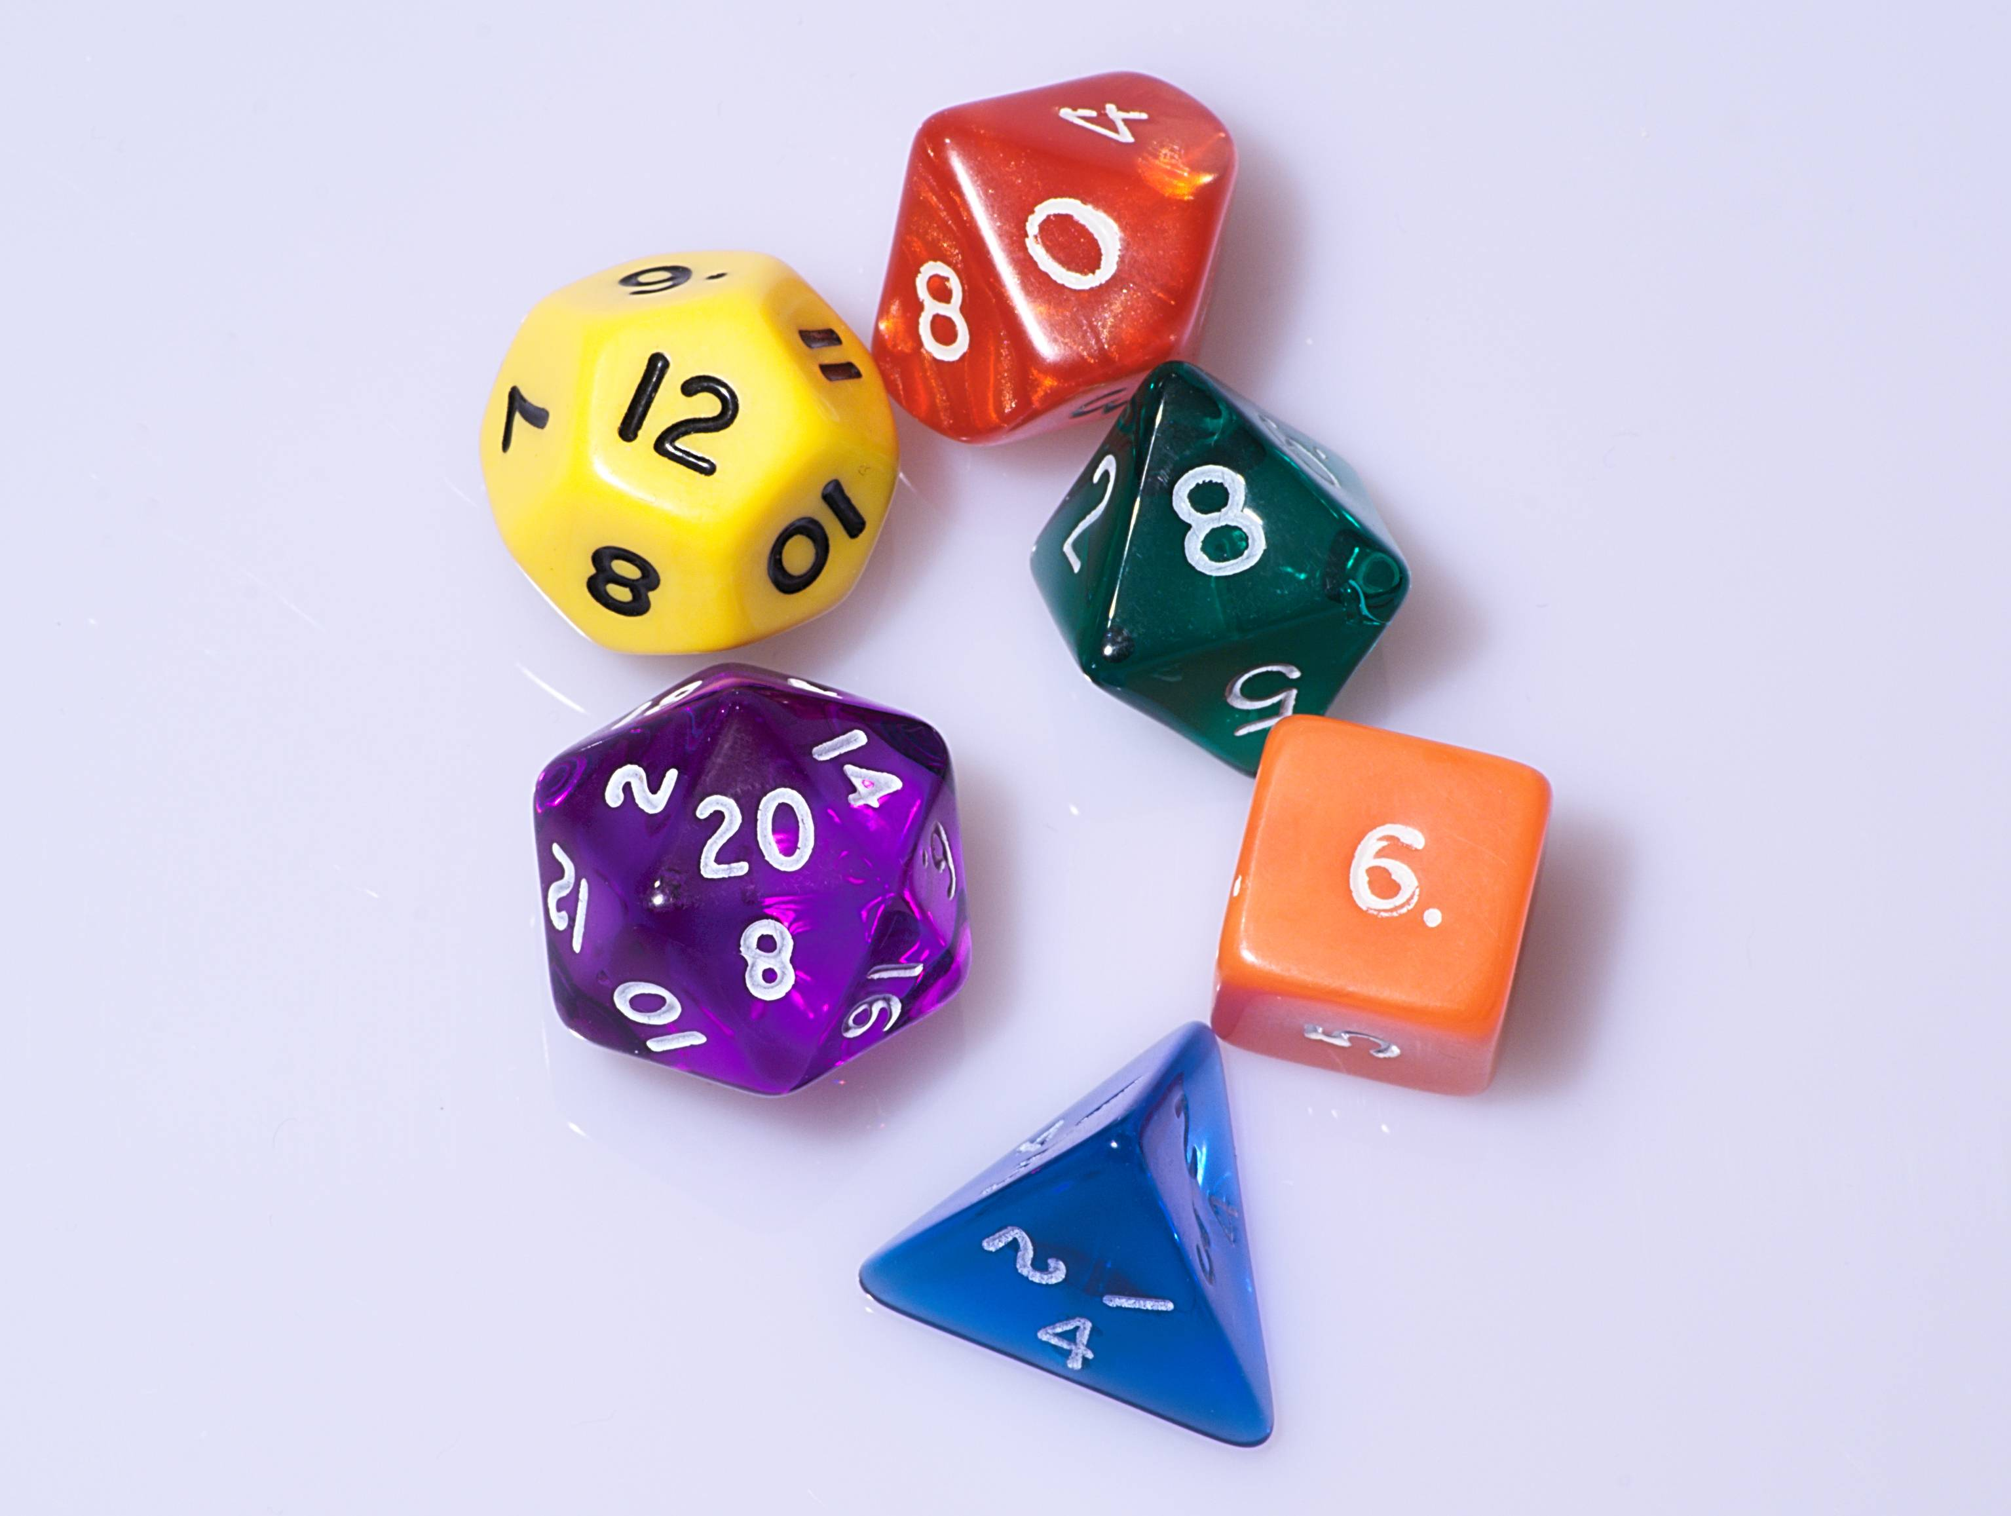
Program Features
Contained in this application are the following resources:
A dice rolling simulation for 20, 12, 10, 8, 6 and 4 sided dice
An initiative tracker for both players and adversaries
A quick reference tab describing player actions, player skills, keywords, situational rulings and status effects
Ultimate goal of the project was to deliver concise tools and information to players in order to reduce clutter and downtime.
NOT trying to make a character sheet as those are easy to find elsewhere made by professionals/official company products.

Slide 4
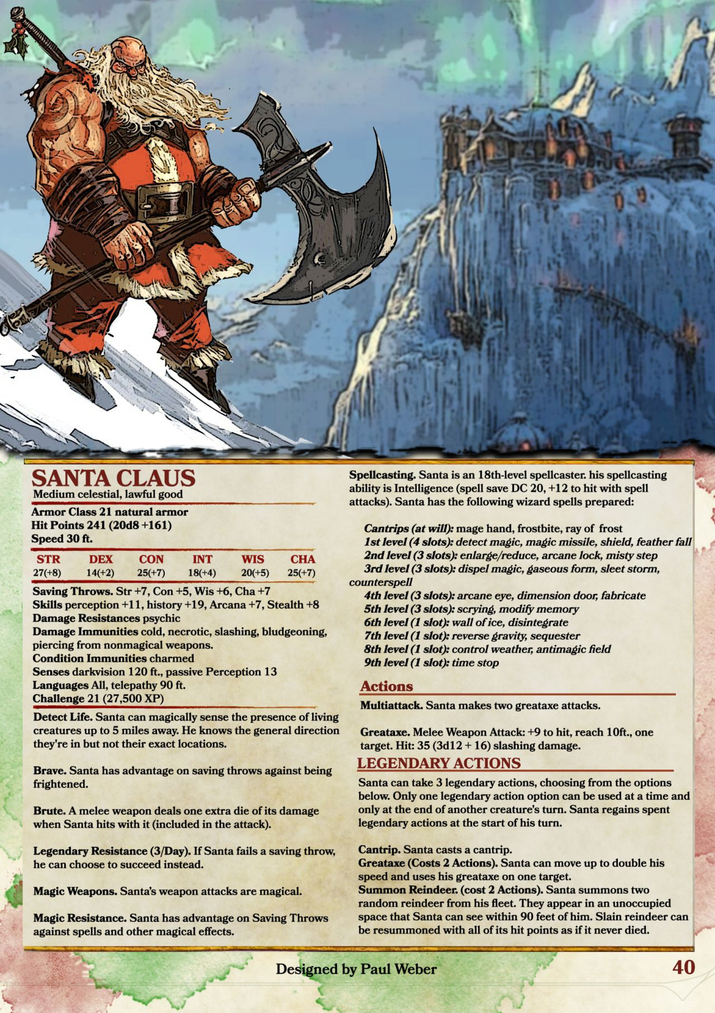
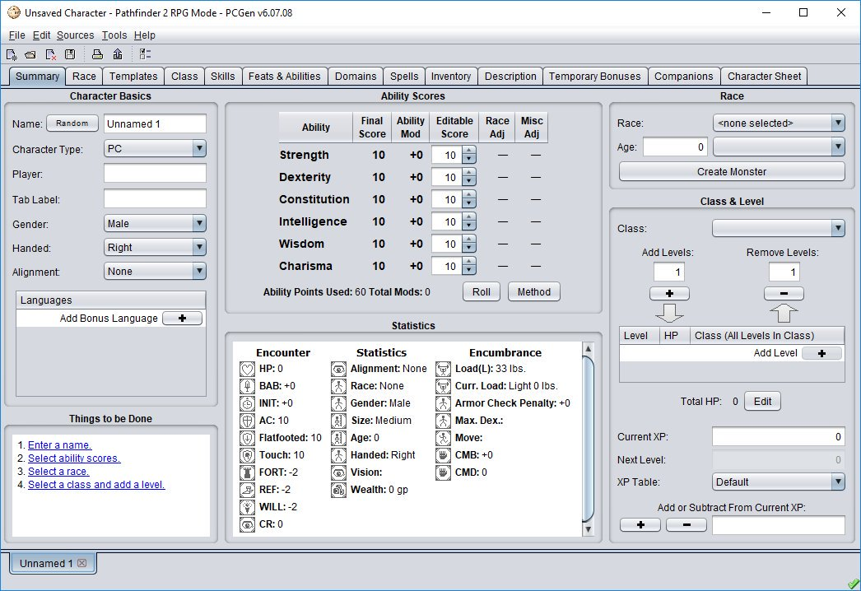
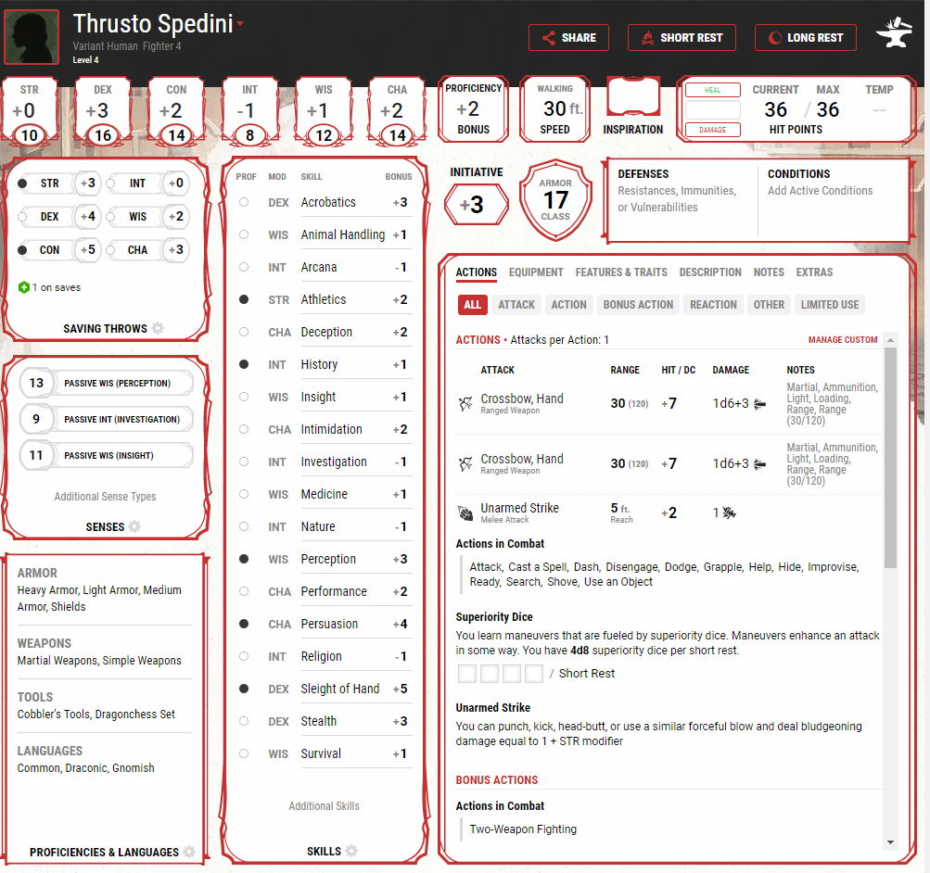
Not any of these =>

Slide 5
Project Evolution
Began from me not finding my dice set. So I whipped up a dice rolling simulation at home 30 minutes before a game.
From there I wondered what other features would be convenient for myself and the other people playing. The idea to track turn order came next.
Lastly, my experience of myself and friends not knowing certain rules or keywords led to creating an electronic reference sheet
Other features were added and removed during this process. If something looked too daunting, wasn’t freely available, or was too much work for a minor aesthetic change it was left out.

Slide 6
Personal Programming Goals
This was the first time I wanted to try building a form with multiple tabs, split panels and control docking.
Wanted to experiment with form controls I’ve seen but not personally used much in Book 1. What properties correspond to user input? What does this button do?
Get used to writing more informative comments for myself and others within the program as a positive habit.
Create an account and post something on a file hosting website.
Make something I’d want to actually use.

Slide 7
Lets look at it

Slide 8
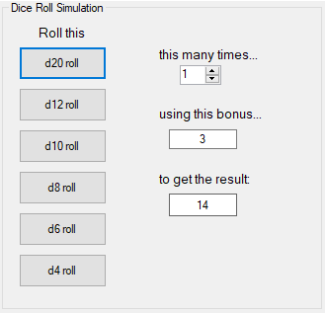
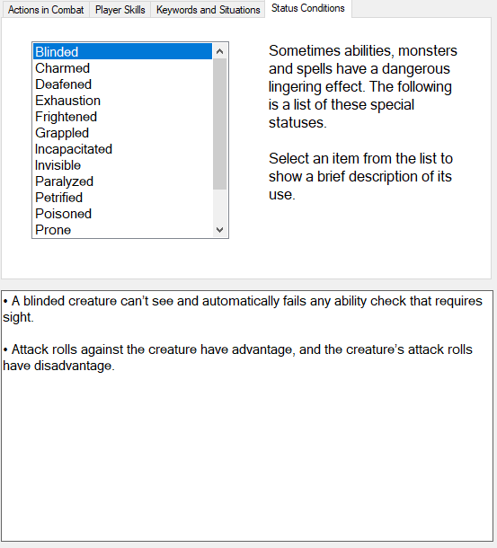
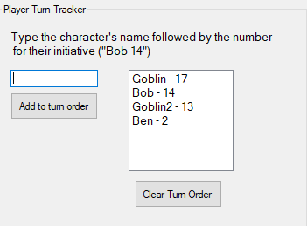
User input takes the form of dice, adding a bonus, adjusting the numeric counter up and down.
Output is result box.
User input takes the form of a name and number.
Output is a sorted list

Slide 9
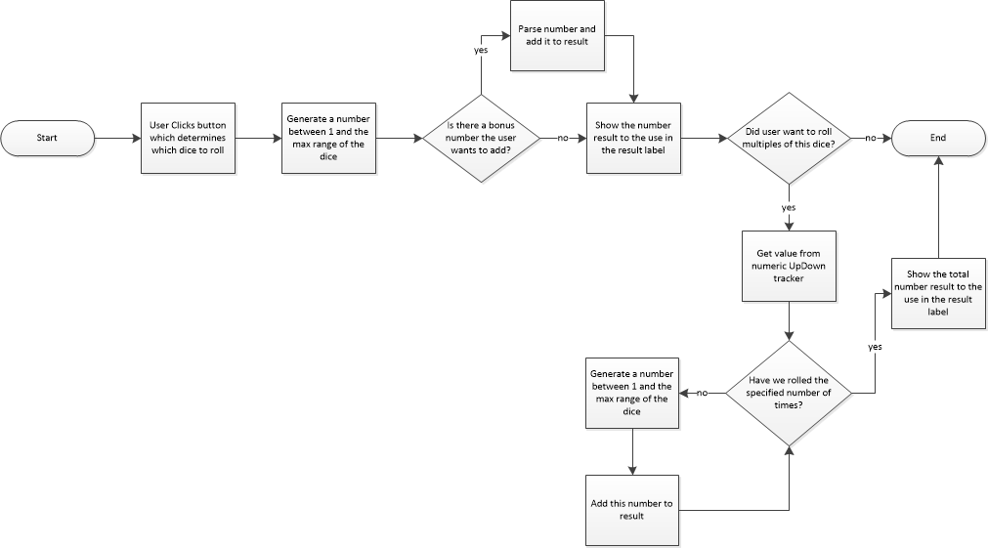
Dice Roller
A user clicks a button stating what size dice to roll.
Generates a random number between 1 and the maxRange
Add bonus to roll if any in userBonusTextBox
Show the number rolled to the user
If user wants to roll more than one die at once, roll the specified dice the selected number of times while adding the result each time

Slide 10
Looking Back, Looking Ahead
There are a few small visual incongruities like the four sections not lining up the way I wanted. Group boxes consider their “top” an invisible line along the top of their title text. This is one example I decided not to fix.
I considered adding a searchable spell listing with a database holding all 400+ spells now in the game.
There could also be added animations/sounds or images in the dice roller that show a picture of the result rather than a label.
In the end it ended up being a little less of a “coding challenge” and a lot more rules analysis than I expected at the outset. At the same time it does exactly what I needed it to do.
I look forward to trying it out and seeing what my friends think. Might change things based off their feedback.

